Slide 1
Crop Recommendation-autoai
CAPSTONE PROJECT
Presented By:
1. Y Nithya kalyani –presidency university-cse(iot)

Slide 2
OUTLINE
Problem Statement
Proposed System/Solution
System Development Approach
Algorithm & Deployment
Result
Conclusion
Future Scope
References

Slide 3
Problem Statement
Modern agriculture requires optimized decision-making to enhance productivity. Farmers often lack data-driven insights to choose the most suitable crop based on soil and environmental parameters. There is a growing need for systems that recommend appropriate crops to maximize yield and sustainability.

Slide 4
Proposed Solution
The proposed system aims to address the challenge of predicting the required bike count at each hour to ensure a stable supply of rental bikes. This involves leveraging data analytics and machine learning techniques to forecast demand patterns accurately. The solution will consist of the following components:
Data Collection:
Gather historical data on bike rentals, including time, date, location, and other relevant factors.
Utilize real-time data sources, such as weather conditions, events, and holidays, to enhance prediction accuracy.
Data Preprocessing:
Clean and preprocess the collected data to handle missing values, outliers, and inconsistencies.
Feature engineering to extract relevant features from the data that might impact bike demand.
Machine Learning Algorithm:
Implement a machine learning algorithm, such as a time-series forecasting model (e.g., ARIMA, SARIMA, or LSTM), to predict bike counts based on historical patterns.
Consider incorporating other factors like weather conditions, day of the week, and special events to improve prediction accuracy.
Deployment:
Develop a user-friendly interface or application that provides real-time predictions for bike counts at different hours.
Deploy the solution on a scalable and reliable platform, considering factors like server infrastructure, response time, and user accessibility.
Evaluation:
Assess the model's performance using appropriate metrics such as Mean Absolute Error (MAE), Root Mean Squared Error (RMSE), or other relevant metrics.
Fine-tune the model based on feedback and continuous monitoring of prediction accuracy.
Result:

Slide 5
System Approach
The "System Approach" section outlines the overall strategy and methodology for developing and implementing the rental bike prediction system. Here's a suggested structure for this section:
System requirements
Library required to build the model

Slide 6
Algorithm & Deployment
In the Algorithm section, describe the machine learning algorithm chosen for predicting bike counts. Here's an example structure for this section:
Algorithm Selection:
Provide a brief overview of the chosen algorithm (e.g., time-series forecasting model, like ARIMA or LSTM) and justify its selection based on the problem statement and data characteristics.
Data Input:
Specify the input features used by the algorithm, such as historical bike rental data, weather conditions, day of the week, and any other relevant factors.
Training Process:
Explain how the algorithm is trained using historical data. Highlight any specific considerations or techniques employed, such as cross-validation or hyperparameter tuning.
Prediction Process:
Detail how the trained algorithm makes predictions for future bike counts. Discuss any real-time data inputs considered during the prediction phase.

Slide 7
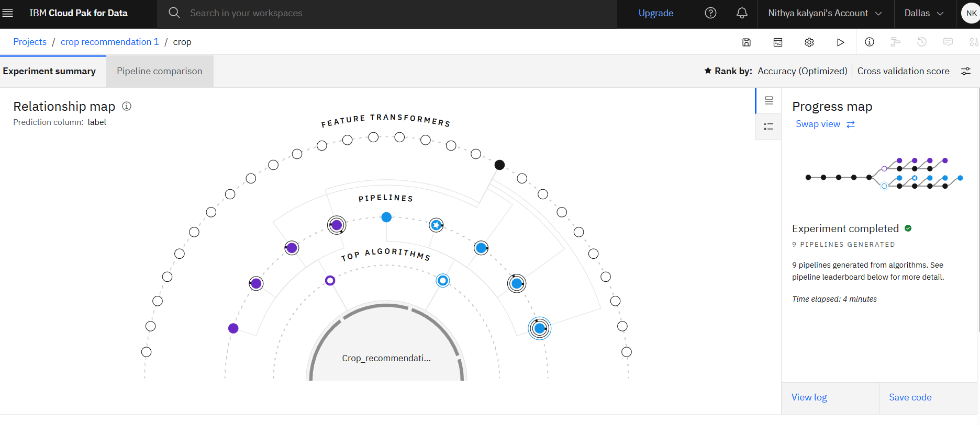
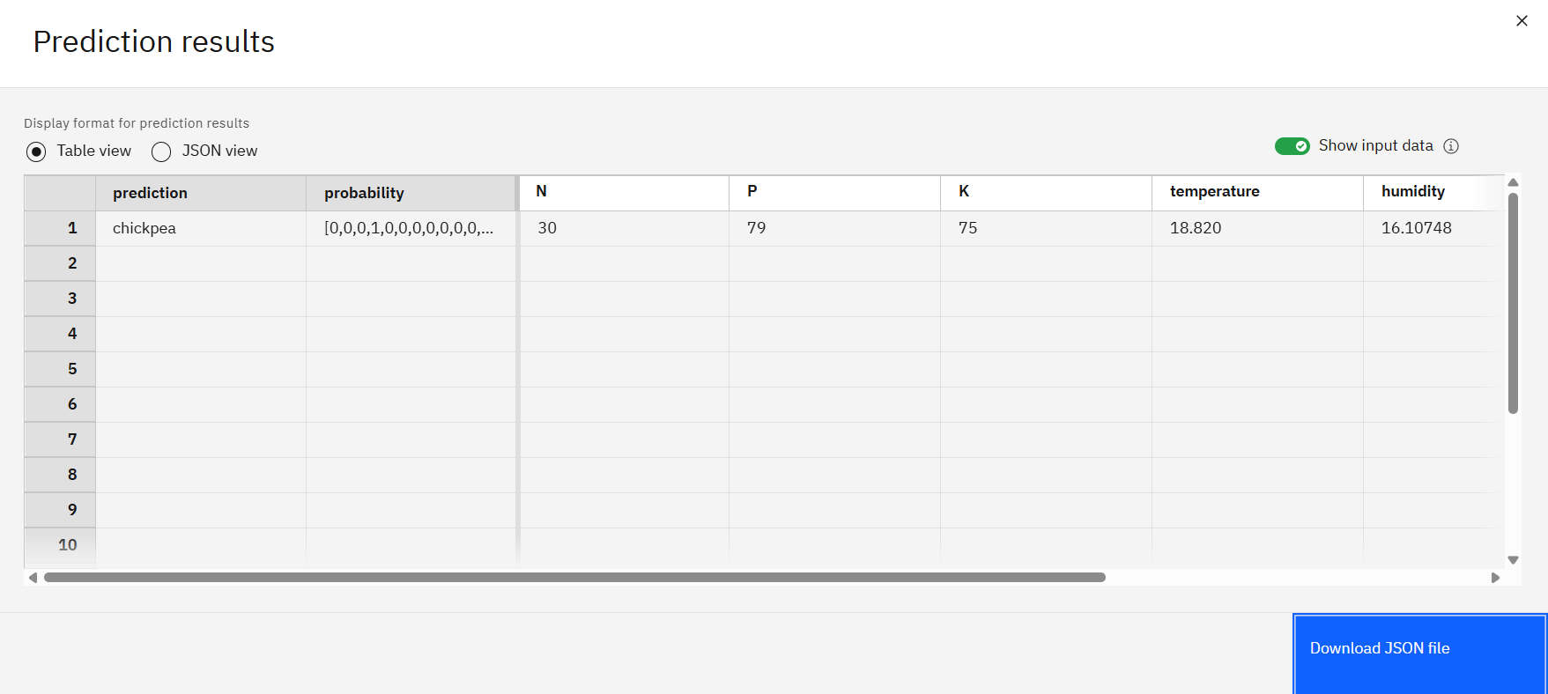
Result
.

Slide 8
Conclusion
IBM Watson AutoAI enabled fast and efficient model development
The system provides valuable decision support to farmers
Promotes sustainable agriculture using data science

Slide 9
Future scope
Integrate real-time weather and soil sensors
Deploy mobile app for ease of use by farmers
Use satellite and drone data for precision agriculture
Expand dataset to include regional or seasonal data

Slide 10
References
https://www.kaggle.com/datasets/siddharthss/crop-recommendation-dataset
https://www.icfa.org.in/
IBM Watsonx.ai Documentation
IBM Cloud: https://cloud.ibm.com/

Slide 11
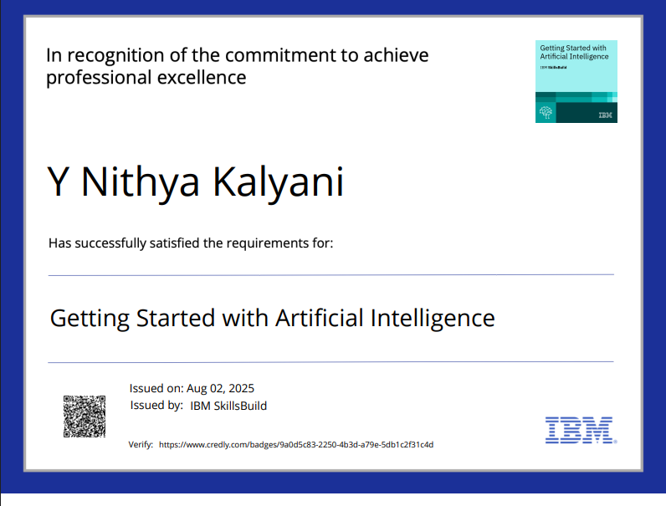
IBM Certifications

Slide 12
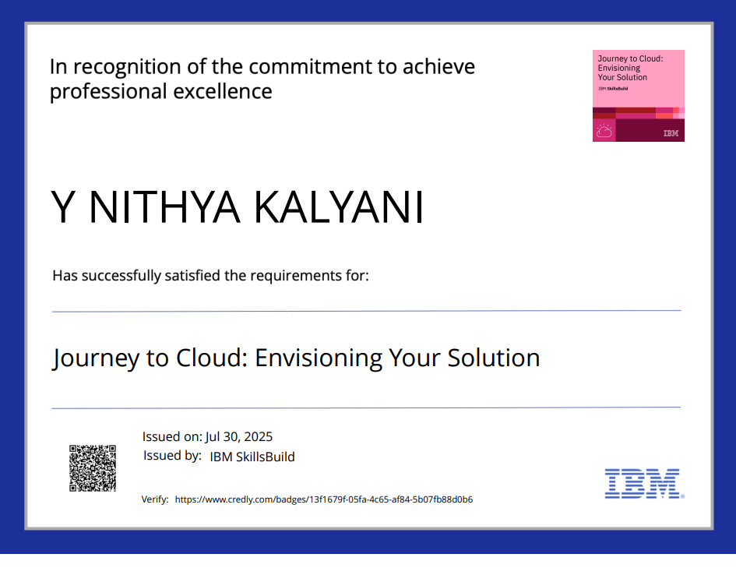
IBM Certifications
Screenshot/ credly certificate( Journey to Cloud)

Slide 13
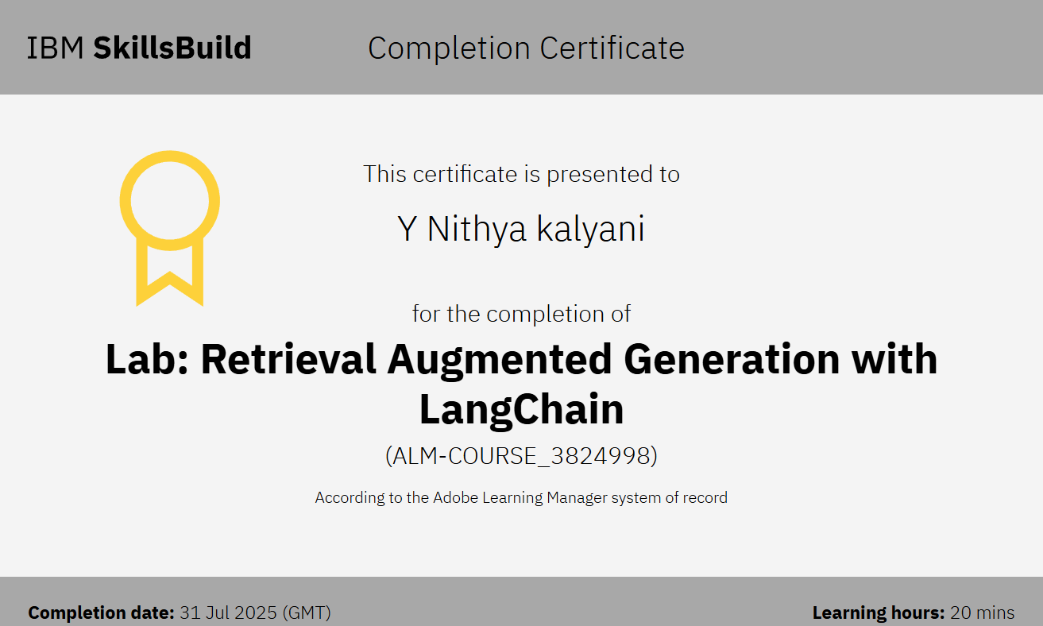
IBM Certifications
Screenshot/ credly certificate( RAG Lab)

Slide 14
THANK YOU

